Slide 1
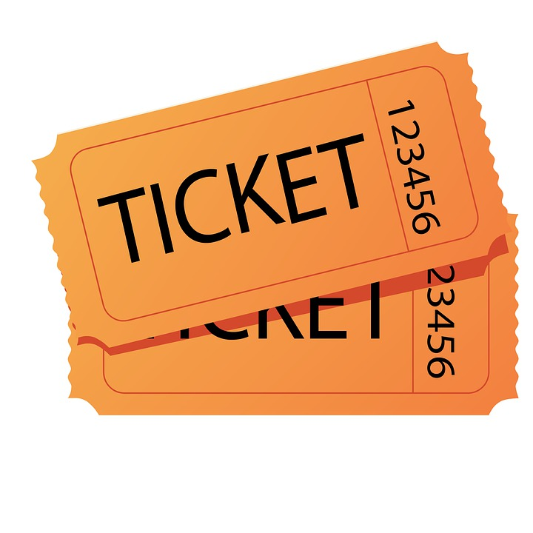
Online Movie Ticket Booking
228 cc batch
Group 7

Slide 2
Abstract
NMS Movies is a Full Stack Web Application for booking the movie ticket online. Here admin can add the movies, manage users, manage purchases, update the movie details, delete the movies from the list, set the availability of the movies, set the discount on movie tickets and user can book the tickets, search the tickets, and view there transactions.

Slide 3
Introduction
Online movie ticket booking system is the process by which customer can purchase their movie tickets using internet and pay through online banking.
It is project is measurable,cost effective and has very good user interface.
This web application is based on angular frontend and curd operation is based on MYSQL ,Hibernate and spring boot.
This System is basically aimed to provide complete information of the movie.

Slide 4
Team Members
Employee Id | Name
2530458 | Nivetha Arul
2530064 | Uma S
2530088 | G Sahana
2529965 | Solleti Venkata Harshavaradhan
2530461 | AnandKumar X
2530123 | Pinnamreddy Avinash Reddy
2530102 | Soma Venkata Vamsi
2529701 | Pradeepkumar V
2527169 | Arulkumaran Thayumanavan

Slide 5
Index
Introduction
Technologies
Methodology
Portal
Registration Module
Login Module
Backend
Admin Schema
Frontend
Angular
Integration
Output
Testing
Conclusion

Slide 6
Technologies
Front end - Angular
Server-side : Spring Boot
Back-end - MySql, Hibernate.
Server - Tomcat

Slide 7
Methodology
Feasibility study
Requirement Analysis
Design
Coding
Testing
Implementation and Maintainance

Slide 8
Portal
ADMIN
USER

Slide 9
Admin Role
Login
Add movie details
Previous order
Online movie ticket booking
User Management
Remove movie details
Purchase Management

Slide 10
User role
Registration
Explore Movie
User cart
Online Movie Ticket Booking System
Online payment and e ticket booking
Login page
Show Time

Slide 11
Registration Module
The registration page enables the user to independently register and gain access to the application.
Every time after your initial registration,you will log on to the application using the username and password as the user created.
It is the way to check your credentials.

Slide 12
Login Module
The Login page allows a user to gain access to an application by entering their username and password
Login page is very common among any types of secured applications and its widely used on the application by the user before presenting the secured pages of the web applications

Slide 13
ER Diagram
Add Movies
Admin login
User login
Previous purchase
Home page
Update Movies
Delete Movies
Available
Movies
Filter and search
Available Movies
Add to cart
Payment and summary
Payment

Slide 14
BACKEND

Slide 15
Spring boot
Spring boot is a java framework ,built on top of the spring,used for developing web application.
Spring boot is a backend framework that has become a major player in the enterprise java EE.
No requirement for complex XML configurations.
It allow you to create REST APIs with minimal configurations.

Slide 16
Admin database Schema
Product details
Id:long id Moviename:String Des:String Duration:String Time:String Category:String Price:float Discount:float Image path:String
Update Movies
Id: long id Moviename:String Des:String Duration:String Category:String Image path:String
Delete Movie
Movie deleted successfully
Admin
Id: integer(pk) Username:string Email Id:string Password:string Contact:long int Address:string
Purchase
Id:long id Totalcost:float Quantity:int Moviename:string Transaction id:stringI

Slide 17
User database Schema
Product details
Id:long id Moviename:String Des:string Time:String Category:String Price:float Discount:float Image path:string
Delete Movie
Movie deleted Successfully
User
Id:integer(pk) Username:String password:String
Cart
Id:long Quantity:int price:float
Payment
Name Card number Expiry date cvc
Purchase
Id:long id Totalcost:float Quantity:int Moviename:string id:string

Slide 18
Rest API
API is to standardize data exchange between web service.Depending on the type of API,the choice of protocol changes.
REST API is an architecture style for building web services that interact via an HTTP protocol.
In spring’s approach to building RESTful web services,HTTP request are handled by a controller.
Postman is an application used for API testing. It is an HTTP client that test HTTP requests,utilizing a graphical user interface,through which we obtain different types of responses that need to be subsequently validated.

Slide 19
Backend Flow
Creating Entities,Controllers for the below modules
Admin
Product
Customer
Cart
Purchase
Performing CRUD operations for above modules using JPA repository

Slide 20
Dependencies and Annotations required
Spring Data JPA - Java Persistence API ad Hibernate
Spring Web - To include spring MVC and embedded Tomcat into your project
Spring Boot Devtools - Development Tools
MySQL Driver - JDBC Driver(Connecting Spring Boot to the Database)

Slide 21
Dependencies and Annotations required
@Autowired : To the UserRepository for dependency injection.
@GetMapping and @PostMapping : To specify the type of HTTP request accepted
@RestController : It is a combination of @Controller and @ResponseBody
@RequestBody : It is used to map the body of the POST request sent to the endpoint to the user instance to save

Slide 22
FRONT-END

Slide 23
Angular
Angular is a platform and framework for building single-page client applications using HTML and TypeScript.
The scope is the binding part between the Html(view) and the javascript(controller).It is an object with the available properties and methods.
SPA -A single page application is a web application or a website which provides users a very fluid,reactive and fast experience similar to a desktop application.

Slide 24
Features of Angular
Cross-platform
Efficient MVC architecture
Data binding
Set of Directives
Prominence of Typescript
Declarative Ul
Extensive documentation and support
Timely upgradations

Slide 25
Components in Angular
Home page
Admin login
Admin dashboard
Product
Cart
Header
Manage Customer
Manage Purchase
Payment Gateway
Order Summary

Slide 26
Integration
1. Backend is connected to frontend through the service.ts.file
2. In services.ts files,httpclient url of backend is added here for integration
* Class AdminService{
Private baseURL=”http://localhost:8084/admin”
Constructor(private httpClient:HttpClient){ }
3. Similarly frontend is connected to backend through cross origin annotation
@CrossOrgin(orgins=”http://localhost:4200”)

Slide 27
Integration
MySQL database is connected to the backend and application
Properties file
spring.datasource.url=jdbc:mysql://localhost:3306/onlinemovie
spring.datasource.username=root
spring.datasource.password=password

Slide 28
Testing
The IOC (Inversion of control)container is one of the primary characteristics of the spring framework. The management of an application object is the responsibility of the spring IOC container.
Inversion of control is achieved using dependency injection.
There are 2 types of testing
Postman Testing
Selenium Testing

Slide 29
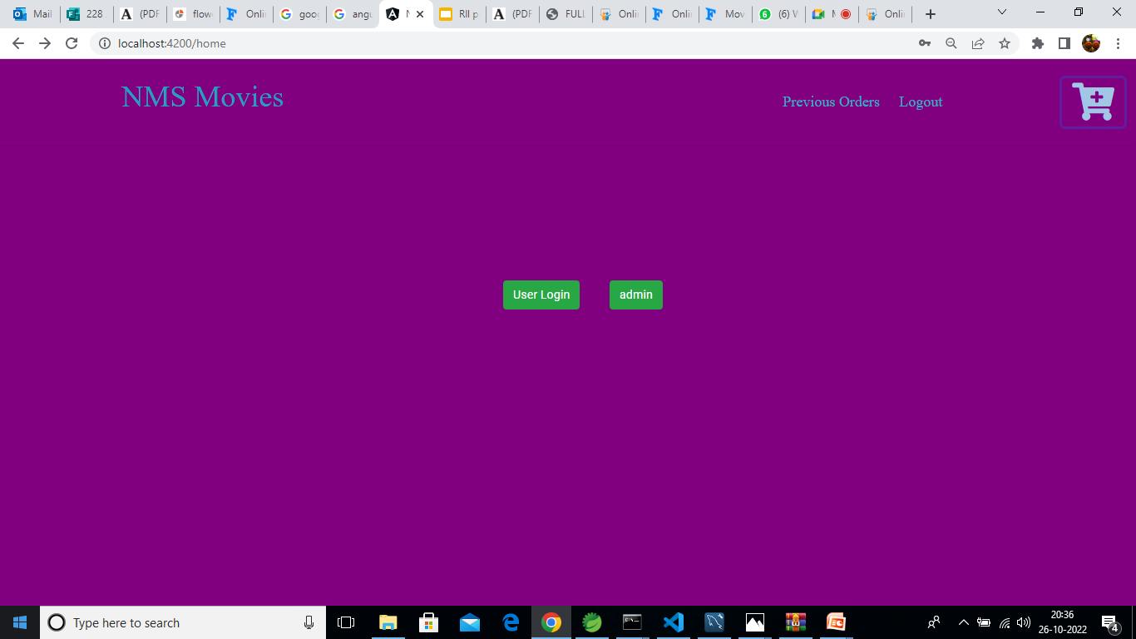
Home page

Slide 30
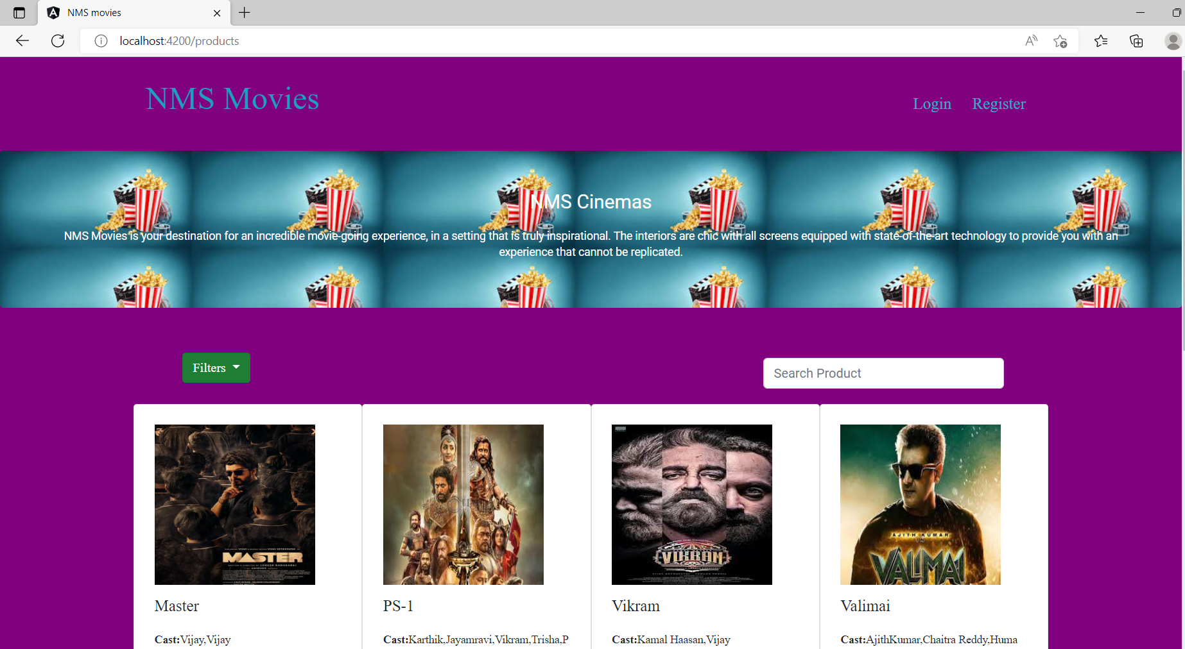
1.NMS Movies

Slide 31
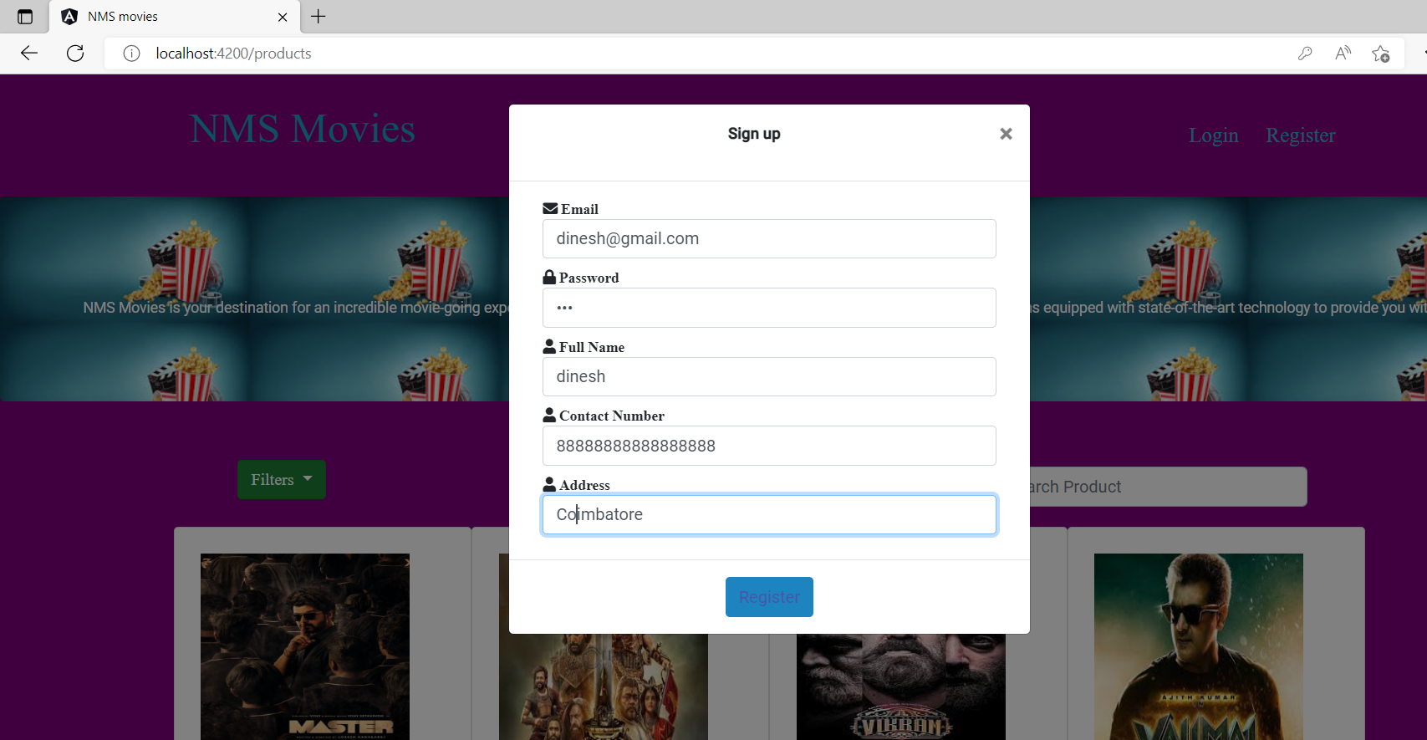
2.Login and Registration

Slide 32
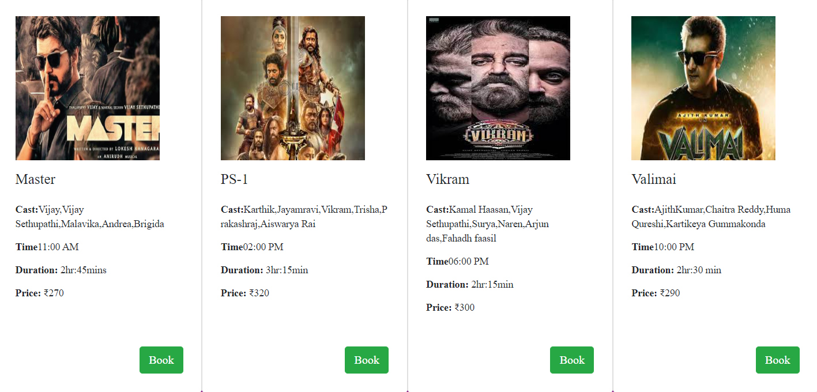
3.List of Movies Running

Slide 33
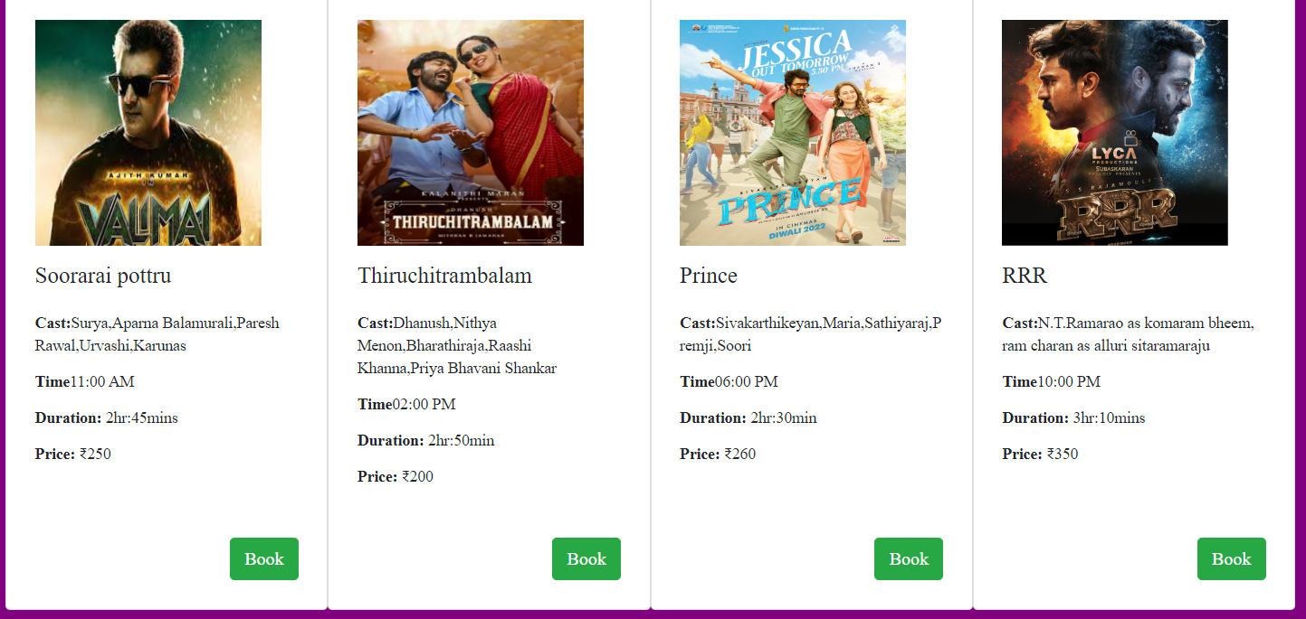

Slide 34
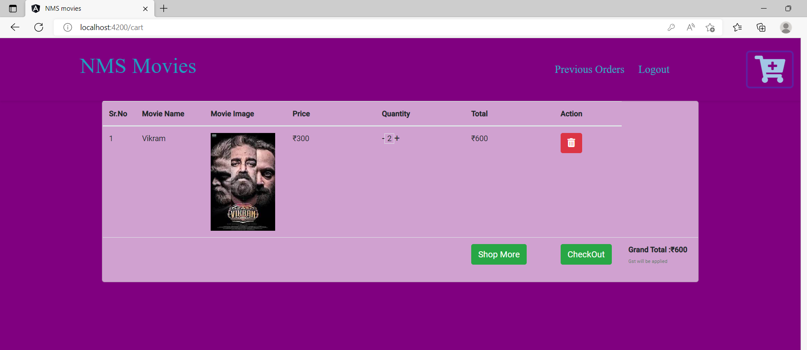
3.Tickets Booking

Slide 35
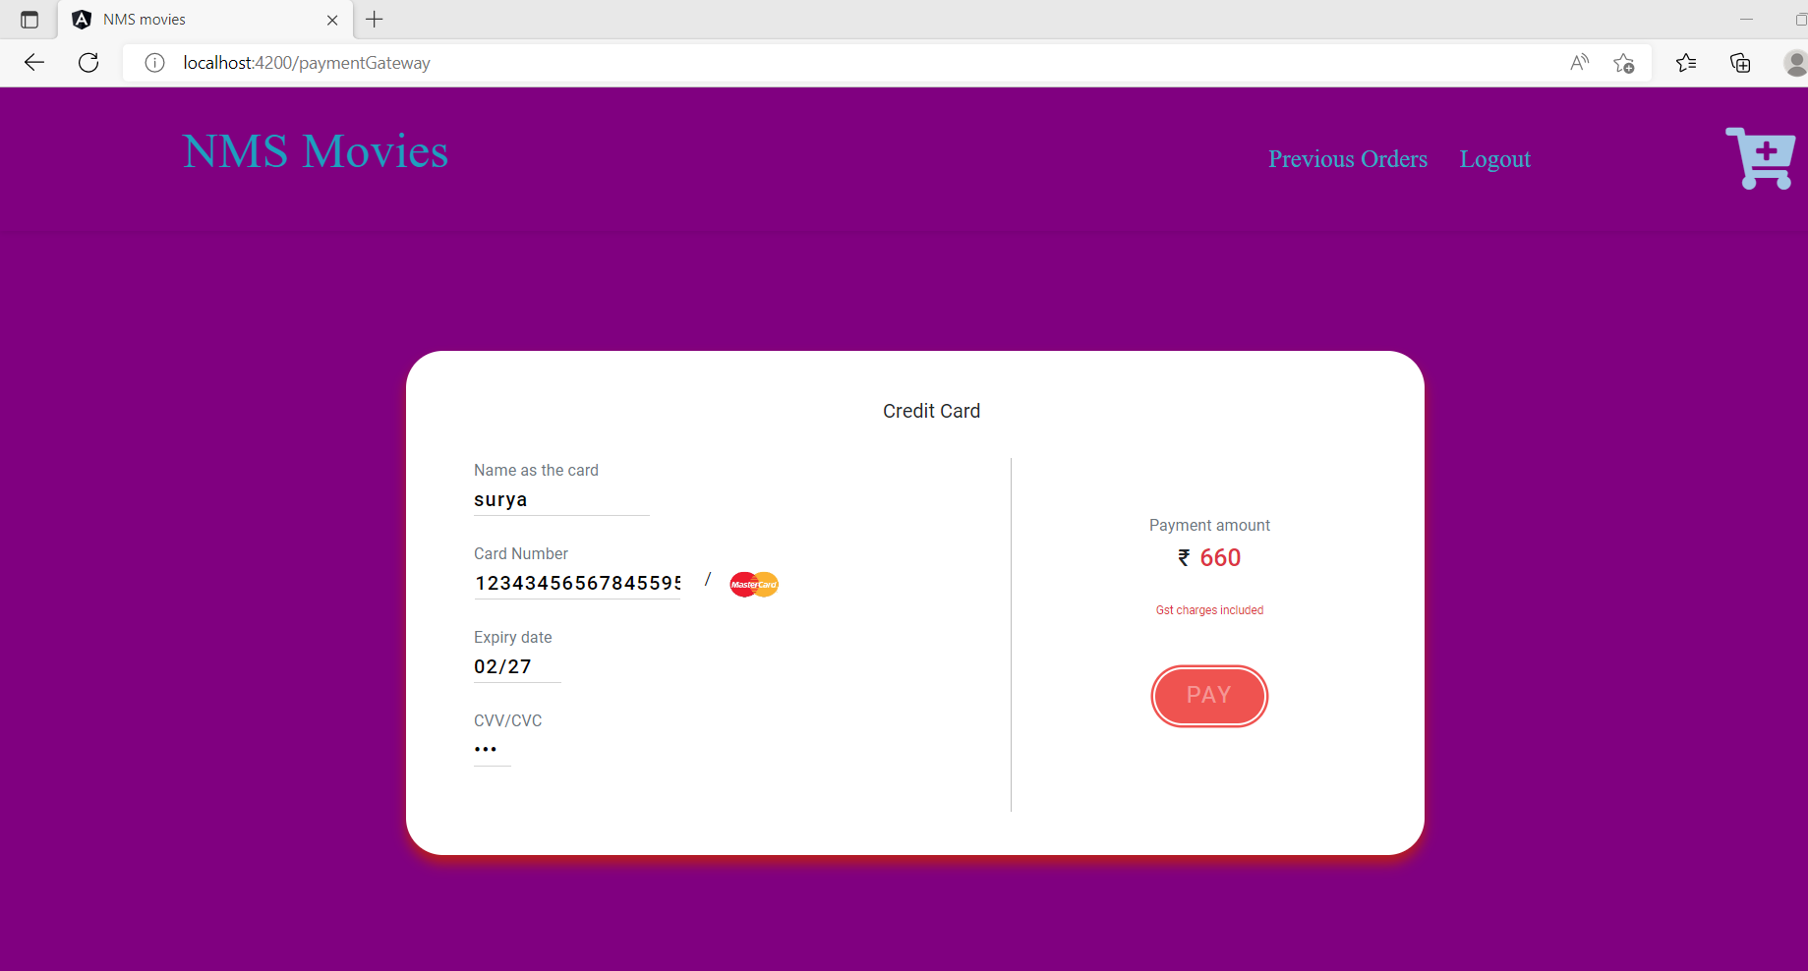
4.Payment Page

Slide 36
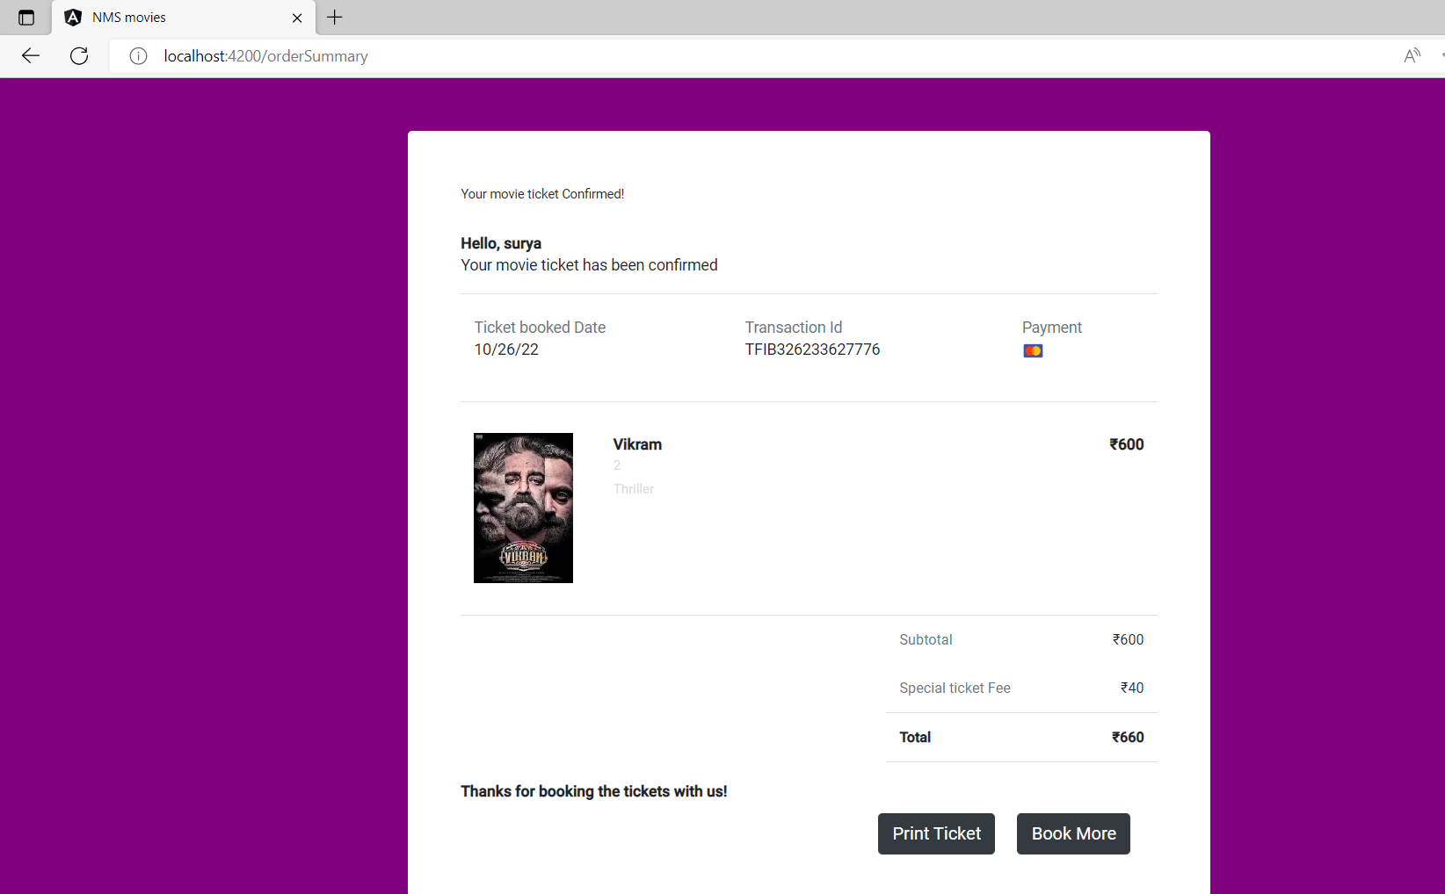
5.Booking Confirmation

Slide 37
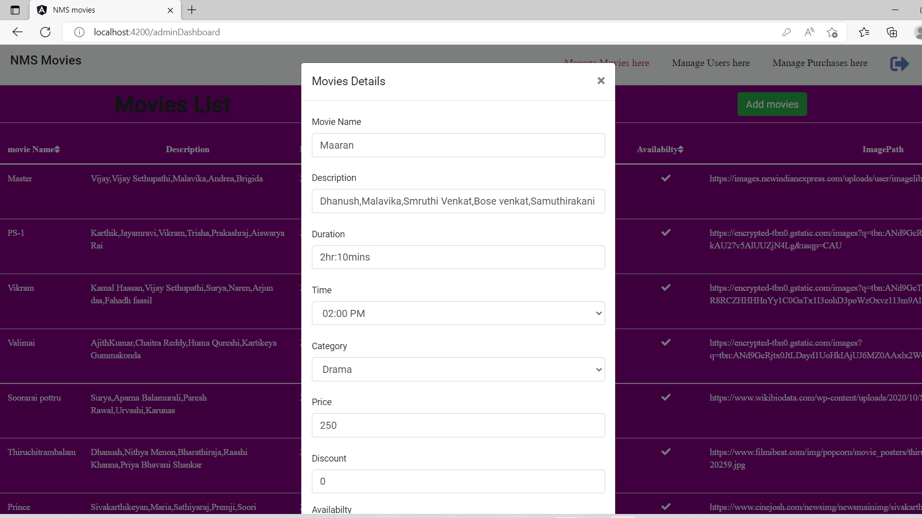
6.Managing Movie Details

Slide 38
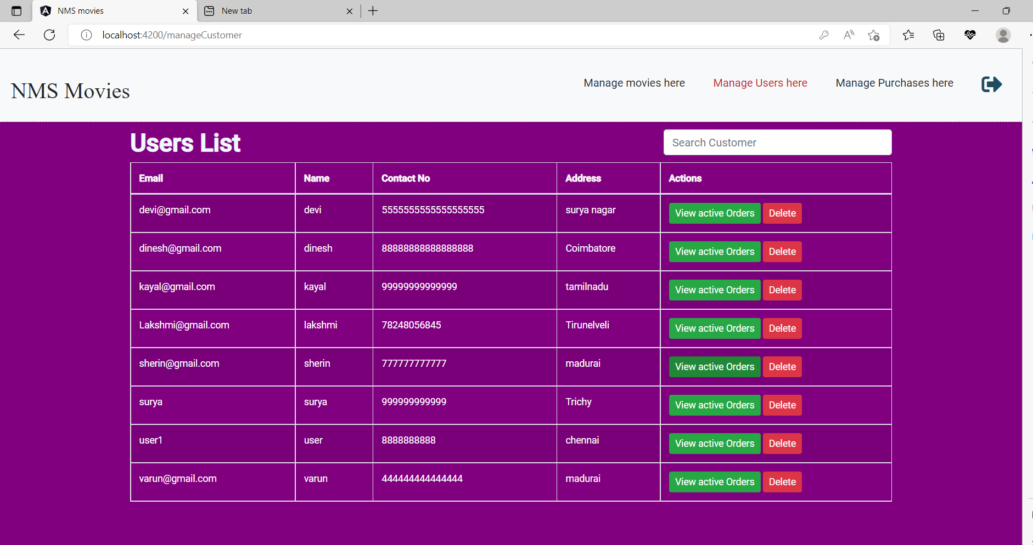
7.Managing User Details

Slide 39
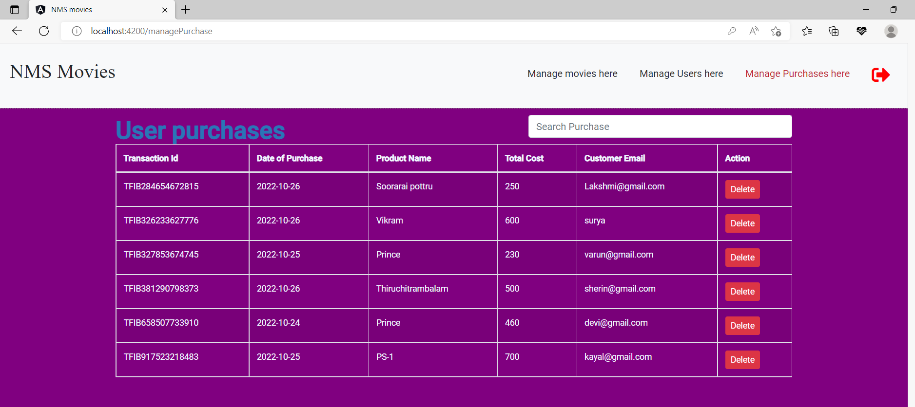
8.Managing Purchase list

Slide 40
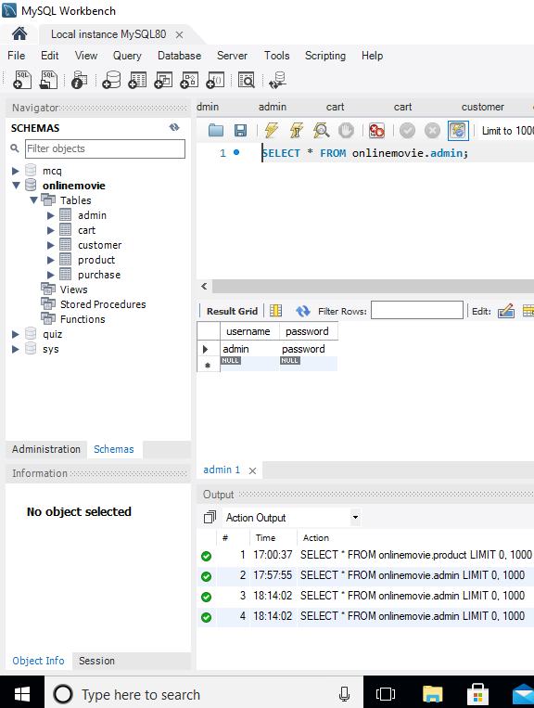
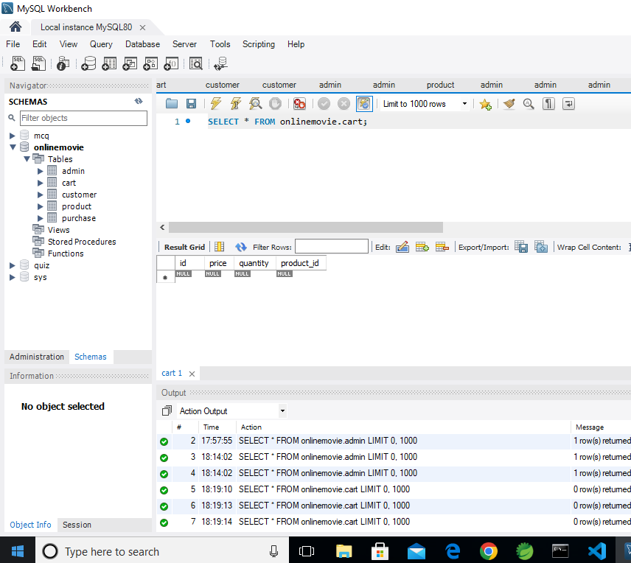
Database

Slide 41
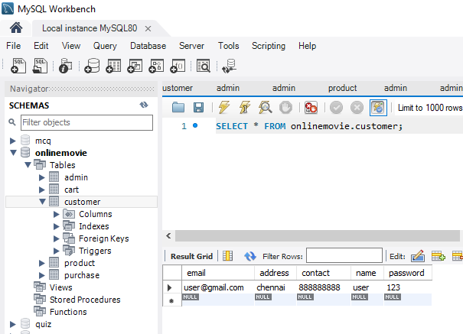
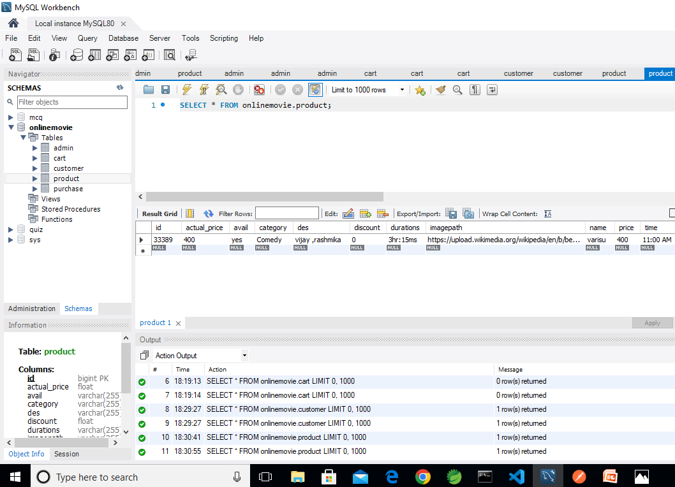

Slide 42
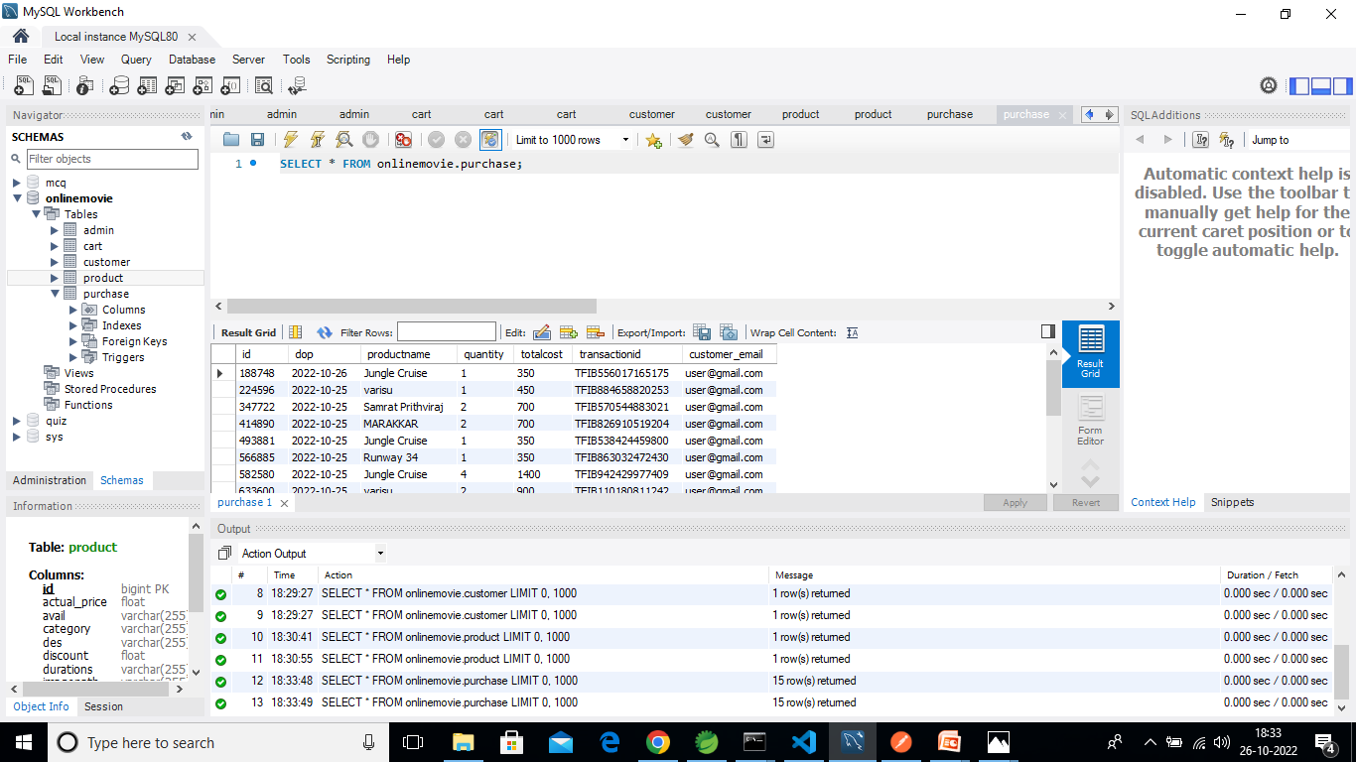

Slide 43
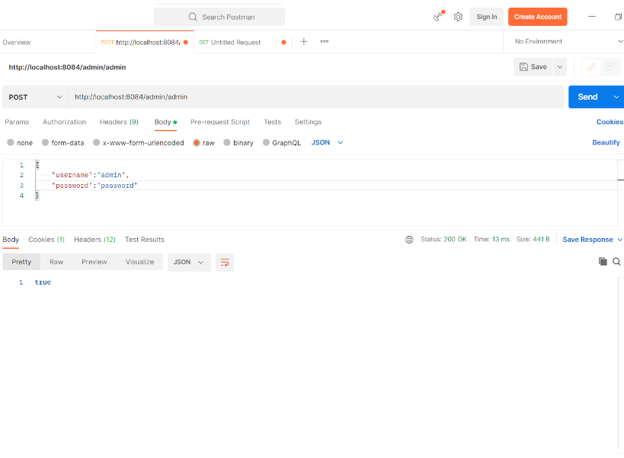
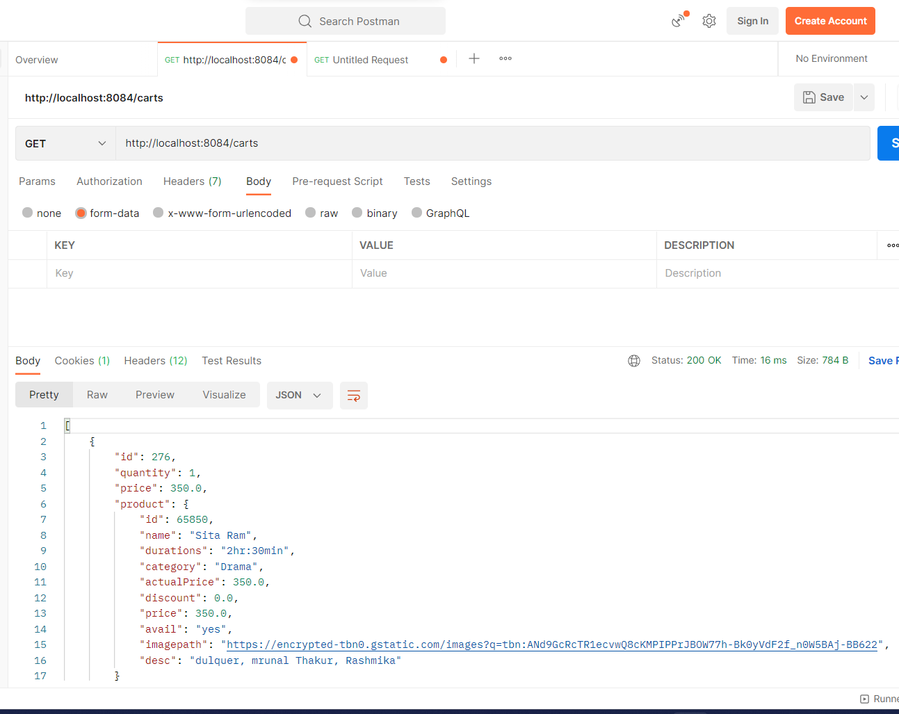
Postman output

Slide 44
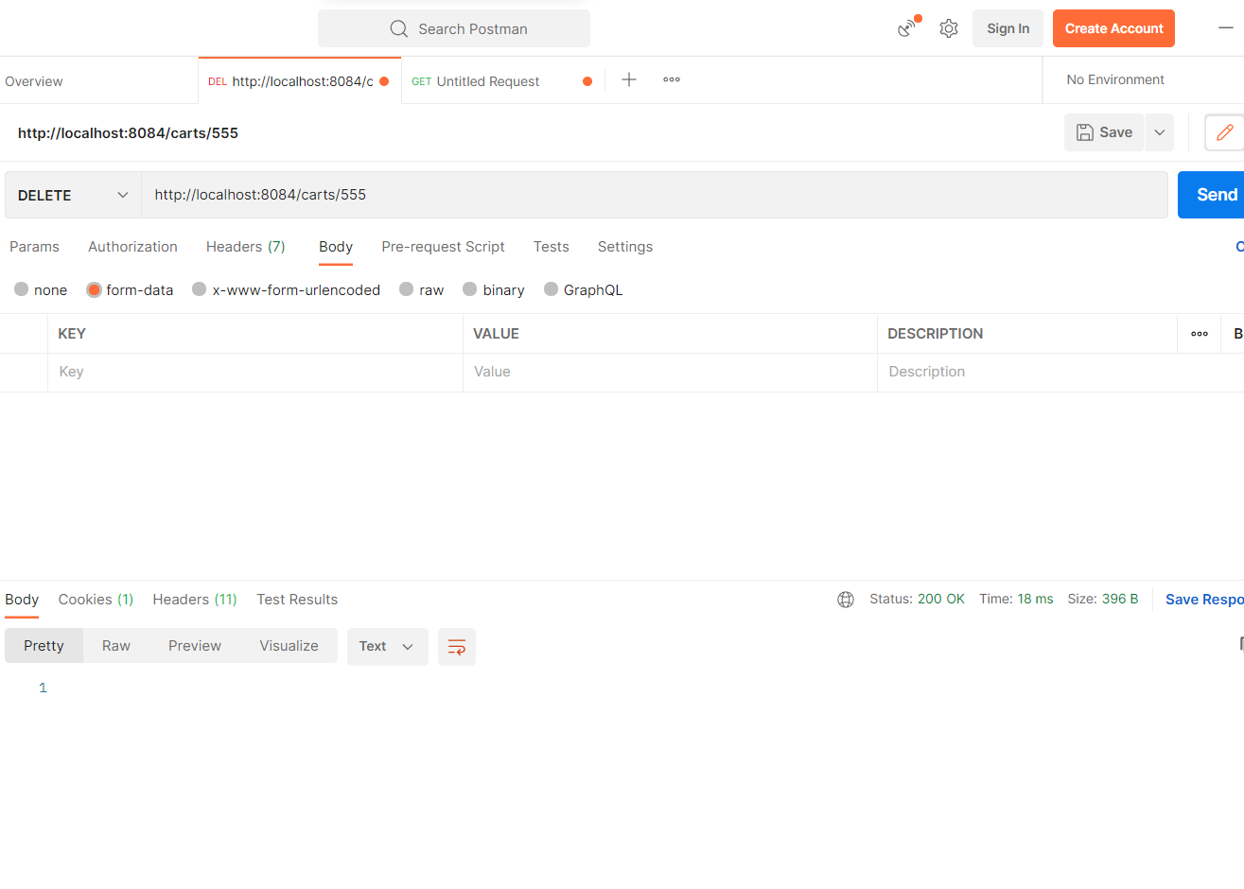

Slide 45
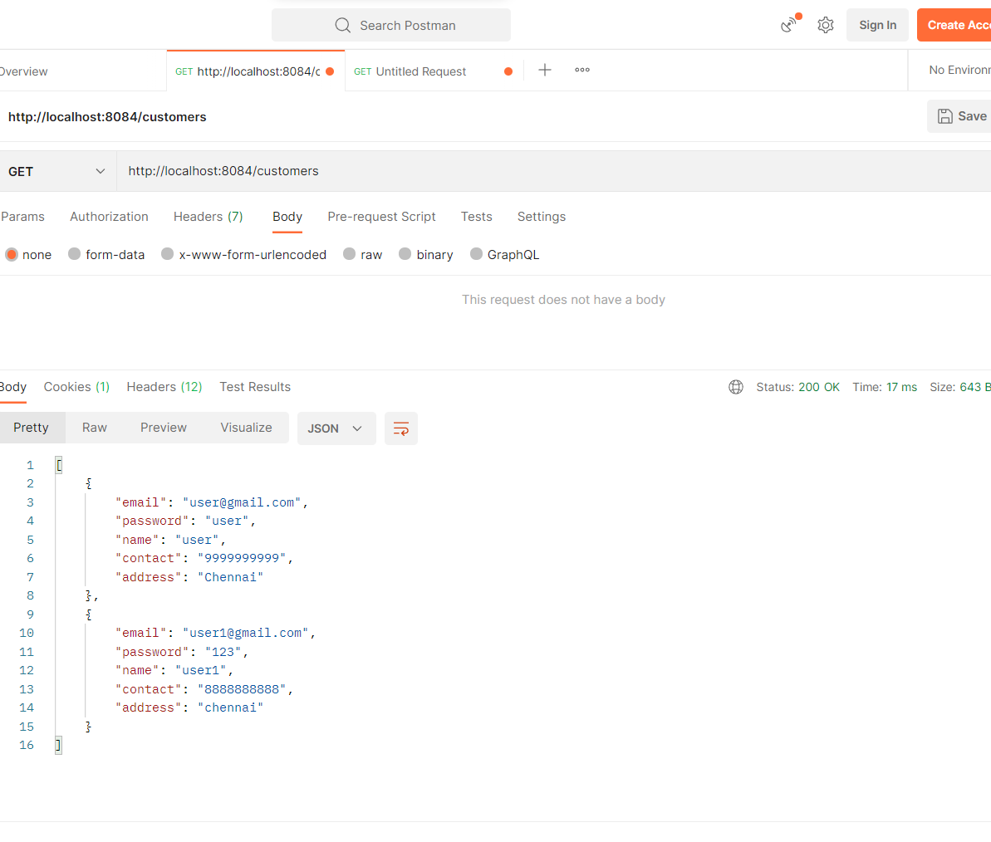

Slide 46
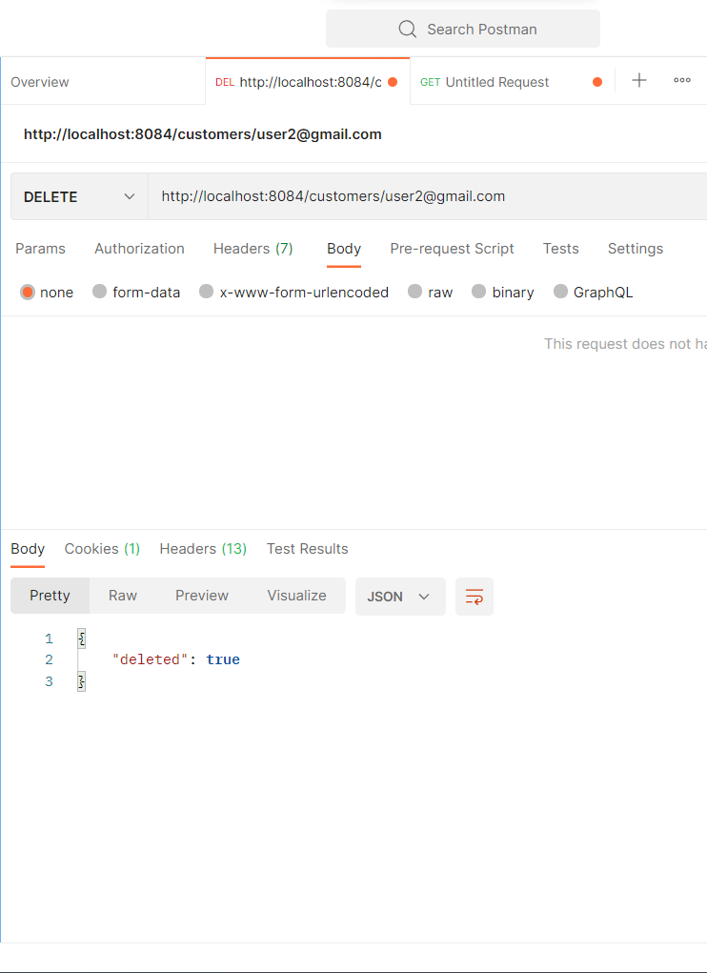
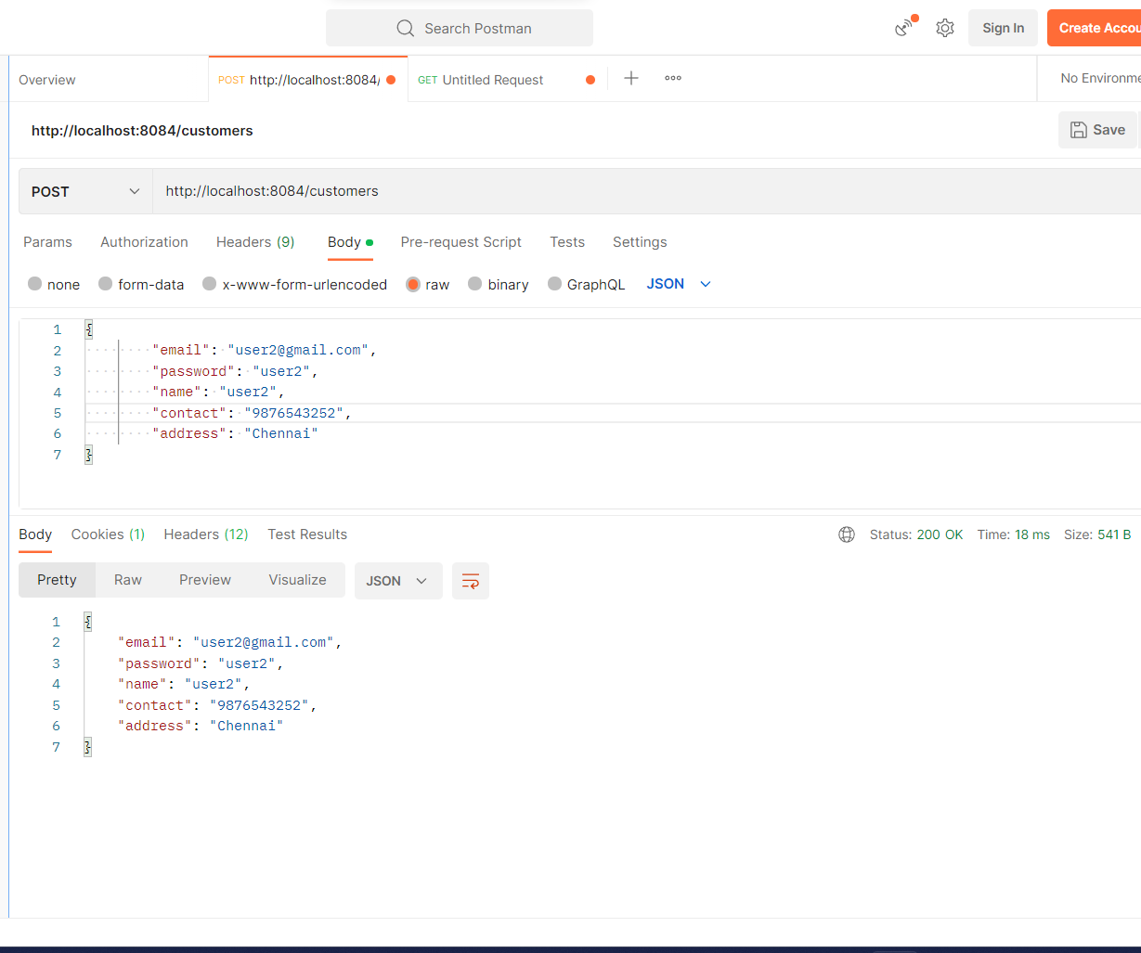

Slide 47
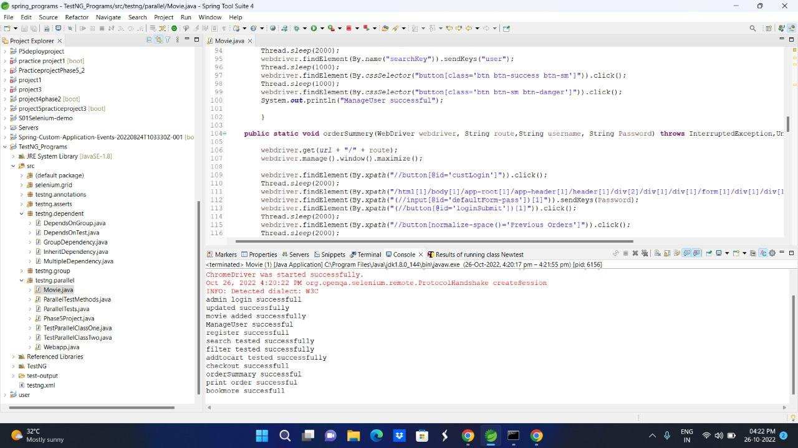
Selenium Testing

Slide 48
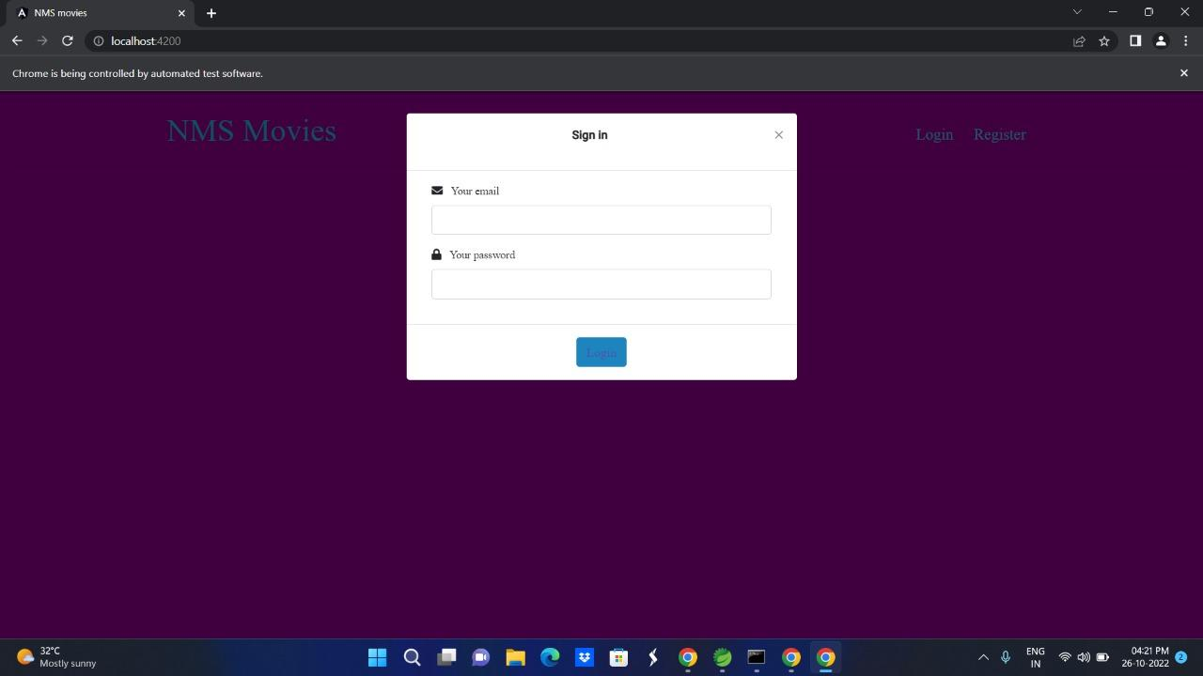
Testing

Slide 49
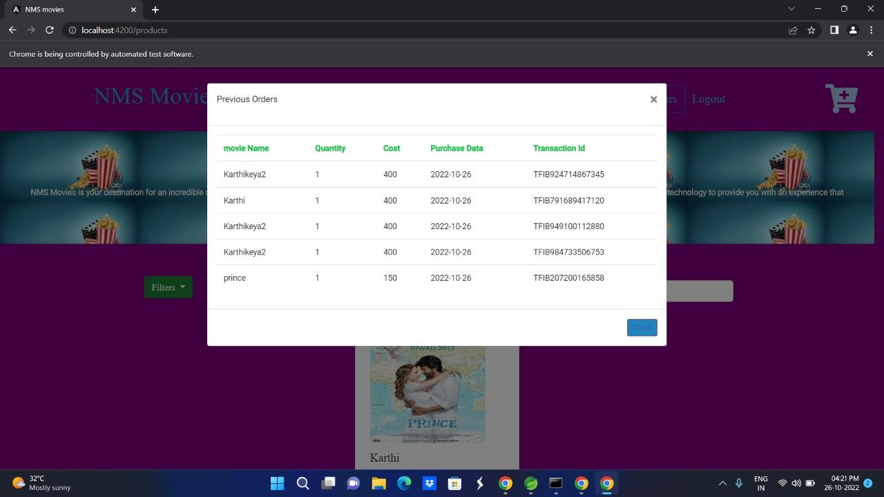

Slide 50
Benefits
An online booking platform helps a movie theatre to meet the needs of their customers and provide them with the very best services.
Most of the software that programmers use is simple to use. They improve user experience, and even administrators find it simple to update the system.
A business can easily gauge how well it is doing by going through the analytics. Data collected digitally is fairly easy to analyze.
Additionally, customers may provide feedback on the services that the company can take into account.

Slide 51
Conclusion
This project has been developed successfully and also has user friendly interface also for the admin to add and delete movie information.
It also helps the customer in having immediate information about running movies and reserve their seat by saving their time.

Slide 52
Thank you

